Slide 1
D E P A R T M E N T O F C O M P U T E R S C I E N C E U N I V E R S I T Y O F C O P E N H A G E N
Descriptors: Detecting Interest Points, attributing them with descriptors and and matching them
François Lauze
Notes:
1
Forelæsning: 32

Slide 2
Plan for today
Detector comparison
Descriptor construction, SIFT
Matching
High level descriptors

Slide 3
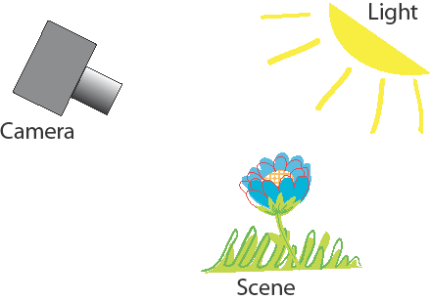
So which detectors are the best?
We Want to Control it All in a Systematic Way
Kim S. Pedersen DIKU, Anders Dahl and Henrik Aanæs from DTU
Interesting Interest Points.
International Journal of Computer Vision, 97:18 – 35, 2012

Slide 4
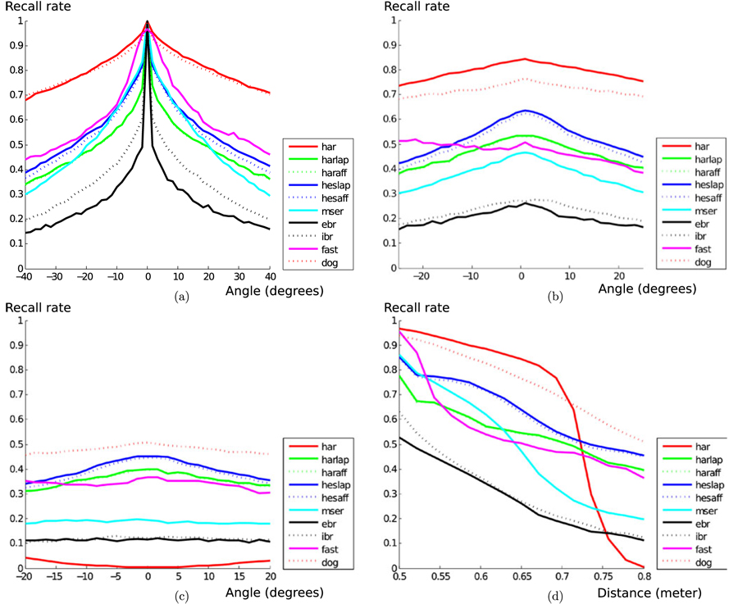
Effect of position
Notes:
Results averaged over all 60 scenes.
DoG and fixed scale Harris does well, except fixed scale Harris performs poorly over scale.
Multi-scale Harris actually perform quite well (/not included).
1

Slide 5
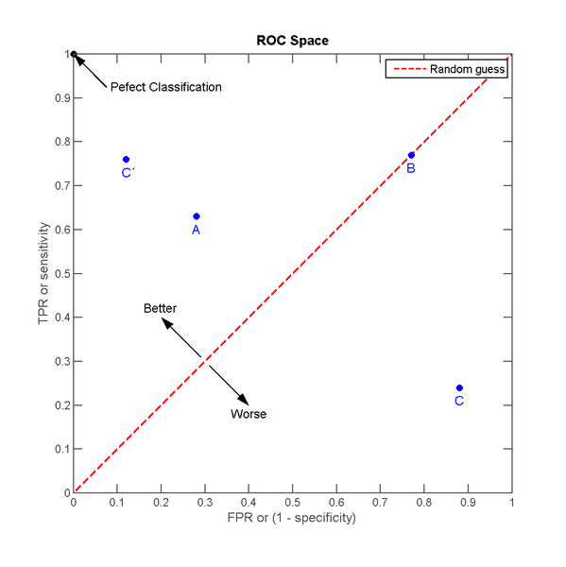
Aside: ROC and AUC?
Receiver operating characteristic (ROC):
TPR = TP / P (Recall)
FPR = FP / N
Area under the ROC curve (AUC):
AUC close to 1 is good
The probability of a correct match
From Wikipedia 2020
Notes:
ROC: Performance summary of binary classifiers (Match or No Match):
Confusion matrix: Summary of frequencies of different types of errors performed by the classifier.
TPR (True Positive Rate): Sensitivity or Recall. Ratio between true positives and all positives. Perfect classifier TPR = 1.
FPR (False Positive Rate): 1-specificity. Ratio between false positives and all negatives. Perfect classifier FPR = 0.
Random guess: Equal amount of False positives and False negatives errors.
As we vary r we get a curve (Draw example on whiteboard).
1

Slide 6
Evaluation results
Light is more disruptive than position (angle & scale).
Many different evaluations on different databases
Best Performers:
Harris Variants
DoG (SIFT Blobs)
Less well performers:
MSER, FAST, Hessian Laplace Variants, etc.

Slide 7
Matching Strategy Illustrated
Extract interest points: Harris corners, DoG (blobs)
Compute feature descriptors: Raw patches, , SIFT,…
Match points by pairing similar descriptors
Notes:
Find potential matches – in principal we can have several candidates
1

Slide 8
What do we wish of a descriptor
We have to attribute each feature point with a descriptor in order to compare if the candidate match is good or not.
Descriptors must be local, informative, insensitive to noise, luminance variations, perspective deformation including rotation, to pixel quantization etc.
We like compact (low dimensional) descriptors but recognize that high dimensional ones may be more discriminative.

Slide 9
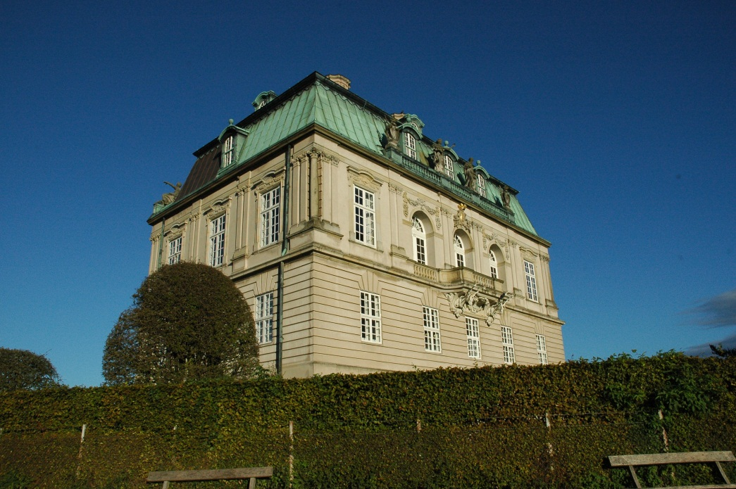
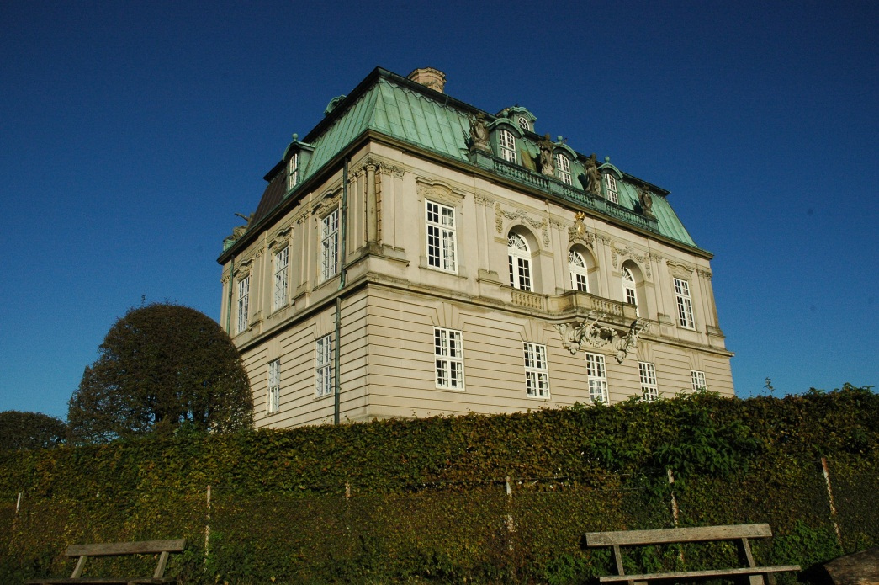
Matching patches
?
Notes:
Is patch F1 similar to patch F2?
1

Slide 10
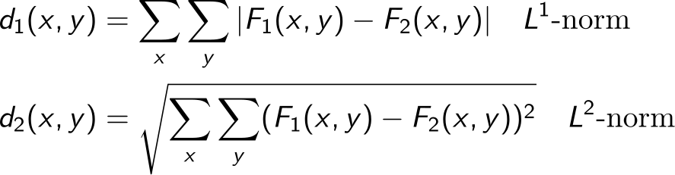
Using raw pixel patches as descriptors
Represent a patch with the raw pixels – the patch is the descriptor.
Compare patches pixel by pixel, e.g. by
(For simplicity lets assume gray scale intensities and the sums are over all pixels in the patches.) (Patches must be of equal size)
This is referred to as either distances or dissimilarities
Notes:
Not similarity measures because we want them to have small values for similar patches and large values for dissimilar patches.
1

Slide 11
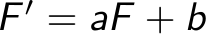
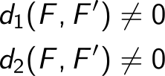
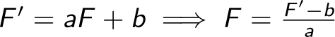
Using raw pixel patches as descriptors
We need to compensate for changes in illumination conditions, because …
Contrast change a and change in brightness level c (affine model):
We want F’ and F to have zero distance, but
Normalisation: can I find a (intensity) affine invariant change?
Notes:
The affine model of intensity distortions is not a completely realistic model, but is a good approximation.
Normalization: So how do we pick a and c?
1

Slide 12
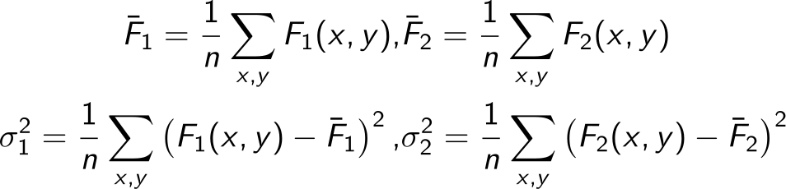
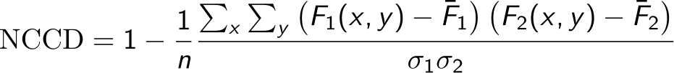
Matching patches: Normalized cross correlation
Compute mean intensity and standard deviation for each patch
(sum over all n pixels in patches)
Measure distance with normalized cross correlation
Affine intensity invariance:
Notes:
Subtract mean to remove additive constant and divide by variance to remove multiplicative contrast change factor. Standard deviation is a good measure of the contrast in a patch – It measures the spread of intensities in the patch.
Can also be interpreted as the angle (dot product) between the two patch vectors.
NOTICE next year: Wikipedia has a mistake in NCC where the sum term is divided by n which gives that NCC is not zero. I have removed this in the equation
1

Slide 13
Matching patches
?
Raw pixel descriptor: Use pixels in patch and compare with Normalized Cross Correlation
Notes:
Is patch F1 similar to patch F2?
1

Slide 14
Open problems
What patch size should we use?
Use the detection scale and resample so both patches have equal size in pixels
Is this approach robust to scale changes in the scene?
Yes, if we do the resampling (see above)
Is this approach robust to rotation in the scene?
No, this will lead to large dissimilarities
Is it robust to perspective distortions?
No, this will lead to large dissimilarities

Slide 15
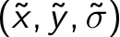
Scale Invariant Feature Transform (SIFT)
SIFT is a very popular descriptor (Google. Scholar says 59369 citations Nov. 2020).
Scale invariance:
This is obtained by using the DoG blob detector which is multi-scale. Descriptor build at these interest points in scale-space.
After detection we have an interest point at
Rotational invariance:
Estimate an orientation of the interest point and build the descriptor relative to this.
Translational invariance:
To some extend by construction of the descriptor (more on this)
Illumination invariance:
By construction of the descriptor (more on this)
Notes:
SIFT is popular and performs well, so lets go into details of what it does.
Several implementations available, but also patented.
16599 citations Nov. 2012
1

Slide 16
SIFT
Notes:
This is the overview – lets go into details with each step.
Orientation assignment is not even on this chart
1

Slide 17
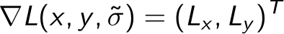
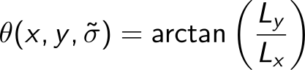
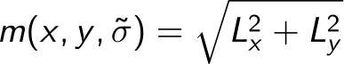
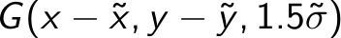
SIFT: Rotational invariance by orientation assignment
At detection scale compute image gradients
Gradient orientation and magnitude images
Build a 32 bin orientation histogram for neighborhood around
Every point weighted with m and a Gaussian window
for all points in the image
Notes:
In SIFT Lowe find the closest scale level in the Gaussian pyramid and compute gradients using pixel differences.
The gradient measures changes in light. The gradient vector points uphill in direction of steepest ascent.
Draw on whiteboard a black and white pattern and point at zero gradient and high gradient areas.
1

Slide 18
SIFT: Rotational invariance by orientation assignment
Find highest peak and its orientation
Create an interest point descriptor using this orientation
For all other peaks larger than 80% of the highest peak – also create a descriptor using theses orientations.
degrees
Notes:
High peaks mean that we have many gradients pointing in this direction and / or very large gradients. Example: There is an edge near the interest point so its orientations will dominate.
Highest peak is at 170 degrees
Only the peak at 200 degrees is above 80% of the 170 degree peak – height 10
1

Slide 19
SIFT descriptor
Gradient images
Orientation image
8-bin histograms
Notes:
The paper suggest 16x16 pixel initial patches, but it can be larger.
8 bin orientation histograms (45 degrees bin width)
4x4 grid of histograms
Orientation image uses pseudo colors to show orientation angle.
1

Slide 20
The SIFT descriptor: Details
8-bin orientation histograms:
When adding to bin, every data point is weighted with m and a Gaussian aperture window
Adding a data point to a bin also add a little to the neighboring bins (linear interpolation)
Pixels on the other side of a histogram grid border contributes a little to the histogram (linear interpolation)
Feature vector:
Concatenate 8-bin histograms from the 4x4 grid into one vector with dimensionality 4x4x8 = 128.

Slide 21
The SIFT descriptor: Details
Normalization of feature vector:
Normalize the feature vector:
Non-linear illumination changes (e.g. shadows) may cause high gradient magnitudes locally.
Therefore reduce all bin values larger than 0.2 down to 0.2.
Renormalize (normalize again):
Notes:
1

Slide 22
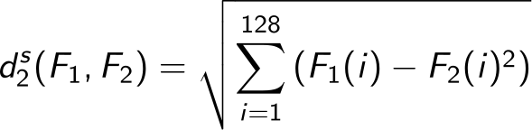
SIFT matching:
SIFT features are compared with Euclidean distance (L2-norm):
Matching SIFT features:
A match is accepted if
Best refers to the distance for the pair of features with smallest distance.
2nd Best refers to the distance for the pair of features with second smallest distance.
Notes:
The sum runs over all the 128 dimensions of the SIFT feature.
Matching: The best match needs to be significantly better than other matches. Best distance <= Next_Best distance hence r <= 1.
This criterion is more stable than just using Best.
1

Slide 23
SIFT Results

Slide 24
The SIFT descriptor invariance’s
Scale invariance:
From the (DoG) detector and further processing done at detection scale
Rotational invariance:
From the orientation assignment procedure
Approximate translational invariance:
From the grid of histograms. Can handle translations up to 4 pixels (within a grid cell).
Affine illumination invariance:
From the choice of gradients additive brightness invariance is obtained. From normalization we obtain invariance to multiplicative contrast change.
Reduction of peaks give some robustness to nonlinear changes such as shadows

Slide 25
Open problems for SIFT descriptors
Perspective distortion, but may be extended to become affine invariant
Non-linear illumination such as cast shadows, changes to light color, and material reflection properties
It is fairly high dimensional (128 dim.) and redundant

Slide 26
Variations on SIFT
There are many variations of the SIFT descriptor:
GLOH
SURF
DAISY
PCA SIFT
Opponent SIFT
Gaussian opponent SIFT
CSIFT
ORB
BRISK
FREAK
…
Notes:
And many more with even more exotic names
1

Slide 27
DAISY – a common SIFT variation: Locations and spread of histograms
Notes:
Notice that DAISY is actually not using histograms but instead splits gradients to positive and negative parts.
1

Slide 28
What is the best descriptor ?
Detector and Descriptor performance is difficult to separate
Much work has been done
Results are not conclusive
SIFT often best, but is very slow, and hard to implement correct. If made affine invariant even slower
SURF sometimes ok, but performance may vary. Fast
ORB, BRISC and other ”binary descriptors” often perform inferior

Slide 29
Aside: ROC and AUC?
Receiver operating characteristic (ROC):
TPR = TP / P (Recall)
FPR = FP / N
Area under the ROC curve (AUC):
AUC close to 1 is good
The probability of a correct match
From Wikipedia 2020
Notes:
ROC: Performance summary of binary classifiers (Match or No Match):
Confusion matrix: Summary of frequencies of different types of errors performed by the classifier.
TPR (True Positive Rate): Sensitivity or Recall. Ratio between true positives and all positives. Perfect classifier TPR = 1.
FPR (False Positive Rate): 1-specificity. Ratio between false positives and all negatives. Perfect classifier FPR = 0.
Random guess: Equal amount of False positives and False negatives errors.
As we vary r we get a curve (Draw example on whiteboard).
1

Slide 30
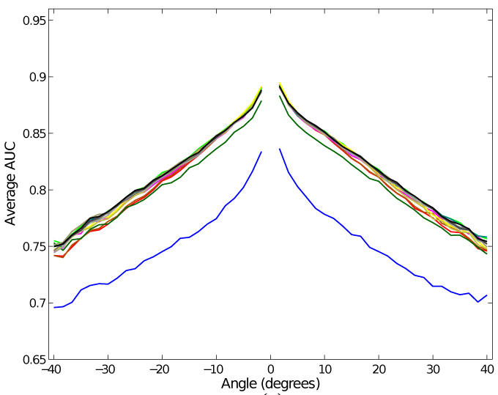
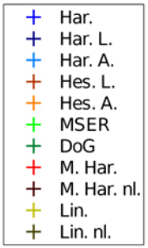
Results at a Glance, Descriptors
Notes:
Each curve represents a descriptor. The blue curve is Raw patch.
AUC averaged over scenes and interest point detectors.
The race is close – most descriptors have close to equal performance!
1

Slide 31
Object detection using Histograms of Oriented Gradients (HoG) features (Dalal & Triggs’05)
Using the sliding detection window approach
Normalization of image prior to detection:
Use all RGB channels
Compute gradient image multi-scale pyramid:
For each color channel, compute intensity gradients
For each pixel, pick the gradient from the color channel with largest gradient magnitude (simple color gradient)
Notes:
Similar in spirit to SIFT, but dense instead of sparse interest points
Gamma correction: Normalize for differences in camera light response functions.
Gamma correction does not have that big an effect.
Gradients: Not using Gaussian derivatives
Training: Done at fixed scale
Testing: Done at all levels in the pyramid
1

Slide 32
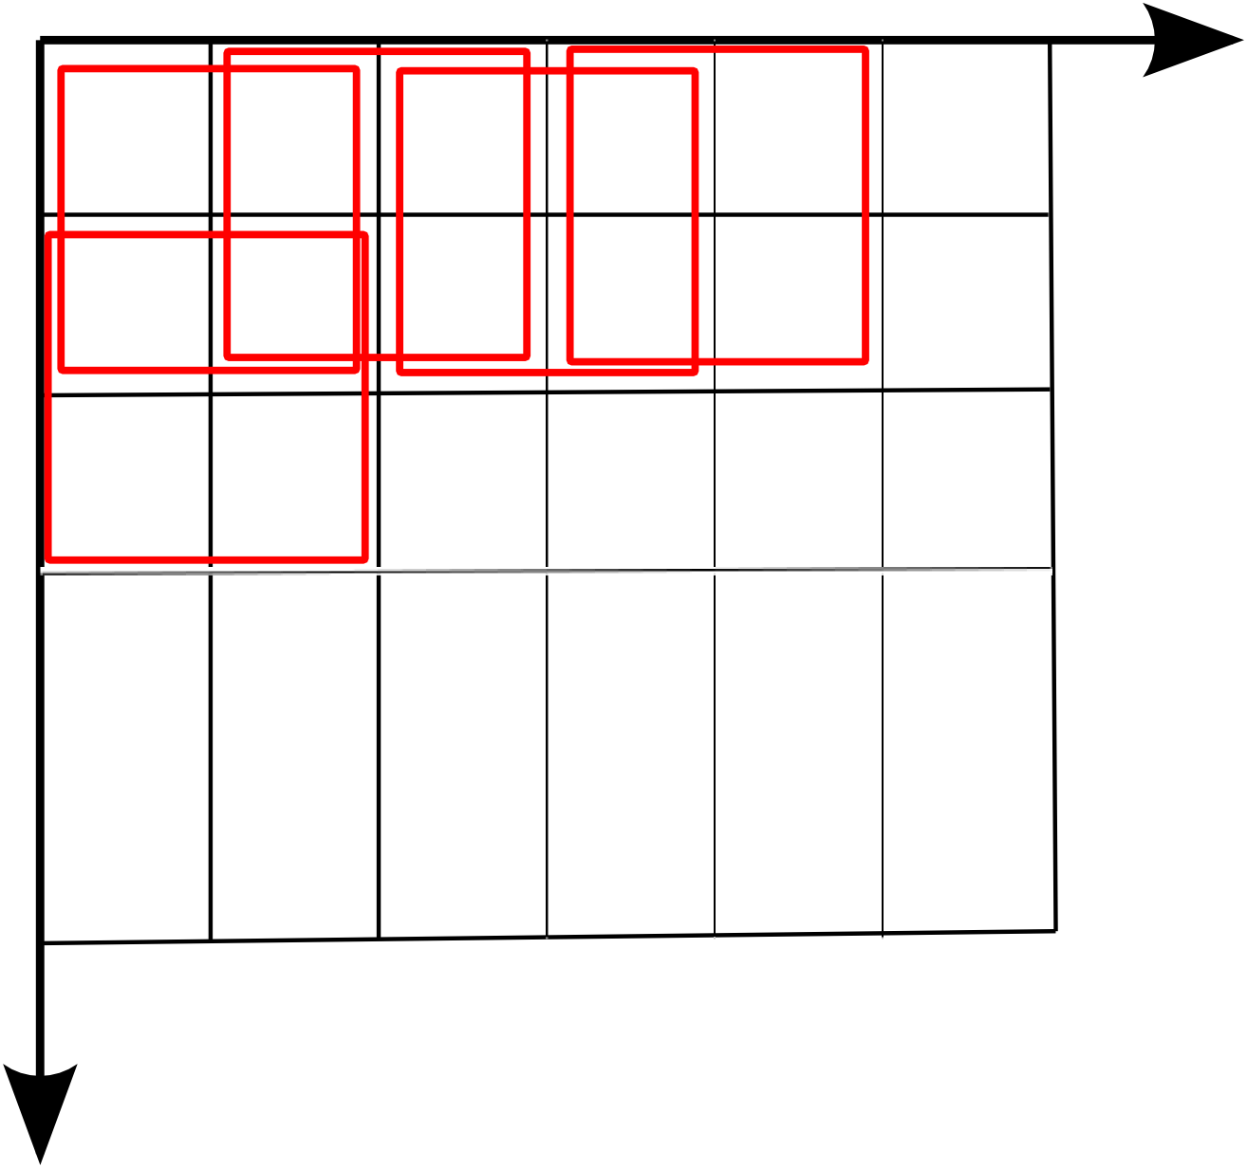
Histograms of Oriented Gradients (HoG) feature (Applied to complete detection window)
Divide the detection window into 8 x 8 pixels non-overlapping cells.
Divide the detection window into 16 x 16 pixels overlapping (8 pixel stride) blocks covering 2 x 2 cells
Cell
Blocks
Cell
Notes:
A Block is similar to a SIFT descriptor, except that it is smaller
Four blocks cover each cell (except at borders we need a wider border)
1

Slide 33
Histograms of Oriented Gradients (HoG) feature (Applied to a detection window)
For each block:
Concatenate cell histogram vectors to a feature vector
Normalize feature vector:
Euclidean:
Peak clipping followed by renormalization (just as in SIFT)
For detection window:
Concatenate block feature vectors to form a joint feature vector for the detection window
Dimensionality for 64 x 128 = 8192 pixels detection window: 9 bins x 4 cells x (7 x 15) blocks = 3780 dimensions
Apply a classifier to the joint feature vector – the detection window feature (Dalal & Triggs uses a linear Support Vector Machine (SVM))
Notes:
The feature vector for a block is similar to SIFT and HoG is concatenation of features from all blocks
Epsilon to avoid zero gradients in flat image regions. This is an issue for dense approaches usually not for interest point based approaches (except for maybe MSER)
Peak clipping = hysteresis
After normalization each cell contributes to 4 blocks (normalization over a bigger area)
More on classifiers in StatML, but we can think of it as learning a filter for the detection window feature
<number>

Slide 34
HoG features visualized
HOG has shown successful in detecting (upright) people, but can be
difficult to adapt to other cases.
Notes:
In the paper they use a soft margin linear SVM, but we could use other classifiers.
Soft margin y(w*x-b)>= 1 – epsilon and minimize
C Sum epsilons + ½ ||w||^2
From left to right:
Average gradient magnitude image over all training images (a “ghost” of the training set)
Maximum positive SVM weights per block (most likely pedestrian)
Minimum negative SVM weights per block (most likely non-pedestrian)
Test image
HoG (for each block accumulate the 4 cell histograms)
And g) HoG weighted by SVM positive / negative weights (positive and negative class)
<number>

Slide 35
- David Lowe’s paper (SIFT-1.pdf in Absalon)
- Next time:
- Imaged formation,
- light models,
- photometric stereo
(much more my cup of tea...)

